Slide 1
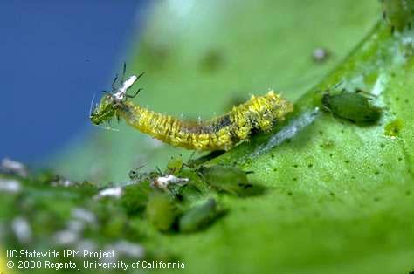
Biological Control
in Gardens and Landscapes
Statewide Integrated Pest Management Program
Notes:
This presentation is about enhancing and using biological control in gardens and landscapes.
Photo: Syrphid fly larva (Syrphidae) preying on an aphid.

Slide 2
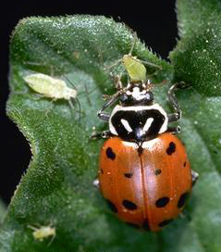
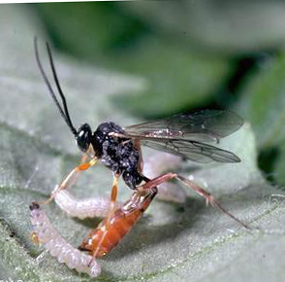
In this presentation you will learn:
Why biological control is important for healthy landscapes.
Types of natural enemies.
How to identify common beneficials.
How to encourage natural enemies by using an IPM program.
Notes:
You will learn what biological control is and why it is important to the health of your garden. You will also learn about the different types of natural enemies and how to identify common species. You will also learn how to enhance the activities of beneficials in your landscape by employing integrated pest management practices.
Photos: Beneficial mini-wasp laying its egg in a caterpillar (left); lady beetle (ladybug) eating an aphid (right)

Slide 3
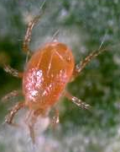
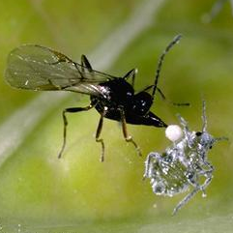
What is Biological Control?
The use of living natural enemies to manage pests.
All pest types, including insects, weeds, plant diseases, and rodents have natural enemies.
Preserve and encourage naturally occurring beneficials!
Predatory mite
Aphid parasite
Notes:
3
What is Biological Control?
Biological control is the use of living natural enemies to manage pests. All pest types, including insects, weeds, plant diseases, and rodents have natural enemies. In gardens and landscapes, biological control is mostly used against insects and mites. Preserving and encouraging naturally occurring beneficials is usually the most effective method of using biological pest control.
Photos: A predatory mite, Phytoseiulus persimilis, (top); An aphid parasite, Diaeretiella rapae (bottom), attacking a cabbage aphid

Slide 4
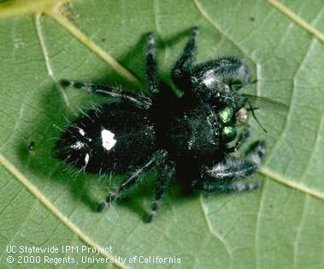
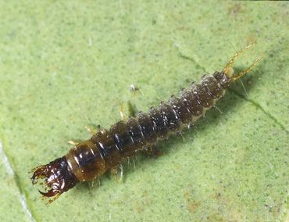
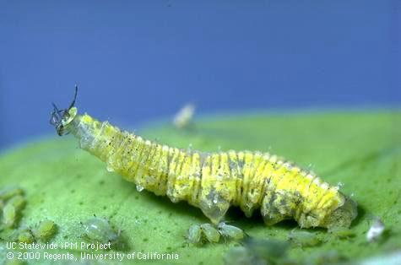
Know Your Natural Enemies!
The most effective natural enemies occur naturally
Hundreds of species are common
Learn to recognize and protect them
Spider→most insects
Beetle larva→soil pests
Syrphid fly larva→aphids
Notes:
4
The most effective natural enemies are the ones that occur naturally in landscapes and gardens. Hundreds of natural enemy species are common and frequently keep pests in check. Learn to recognize and protect them.
Three examples are shown here. The jumping spider at top feeds on many insects. The predaceous ground beetle larva lives in the soil, eating soil insects. The syrphid fly larva is found on leaves and stems, usually consuming aphids.
Photos: Jumping spiders attack most types of insects (top); Predaceous ground beetle larvae eat soil-dwelling pests (bottom left); Syrphid fly larvae eat mostly aphids (bottom right)

Slide 5
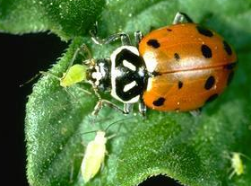
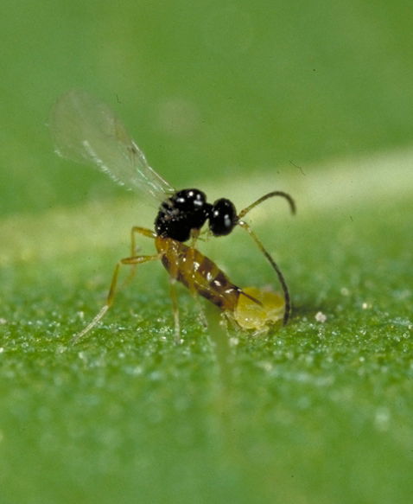
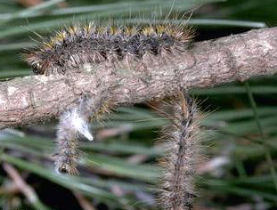
Main Types of Insect Natural Enemies
Predators
Parasites
Pathogens
Notes:
Predators, Parasites and Pathogens are the three main types of insect natural enemies. Let’s learn about each type.
Photos: Predatory lady beetle, Hippodamia convergens, feeding on aphids (left); Walnut aphid parasite, Trioxys pallidus, stinging a walnut aphid (middle); Caterpillars, Lophocampa argentata, infected with a naturally occurring fungal pathogen (right)

Slide 6
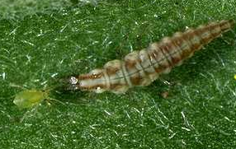
Predators
Eat many prey
Are larger and stronger than their prey
Immatures are predaceous
Adults may also be predaceous
Green lacewing larva→aphid
Lady beetle→aphid
Notes:
Predators, such as the lacewing and ladybeetle shown here, hunt down and kill numerous individual prey. Predators are usually larger and stronger than their prey. In some species, both the adult and immature (larval or nymphal) stages are predaceous. Other species feed on insects only during their larval or nymphal stages and feed on insect honeydew, plant nectar, and pollen as adults.
Photos: Green lacewing larva eating an aphid (top); Convergent ladybeetle, Hippodamia convergens, feeding on an aphid (bottom)

Slide 7
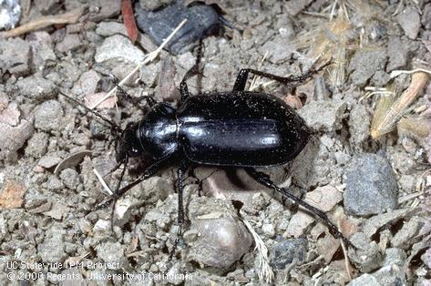
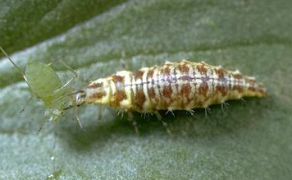
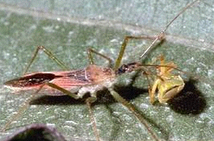
General Predators
Ground beetle→soil invertebrates
Prey on a variety of pests
Examples: lacewings, ground beetles, predatory bugs, and spiders
Present and helpful, but alone rarely control pests
Lacewing larva→soft insects
Assassin bug→most any insect
7
Notes:
7
General predators prey on a variety of pests and vary their diet according to what invertebrates are available or abundant. General predators include lacewings, predaceous ground beetles, predatory true bugs, and spiders. General predators are usually present in landscapes contributing to pest control, but alone, they rarely control pests.
Photos: Predaceous ground beetle adult stalks soil-dwelling invertebrates (top); Green lacewing larvae eats mites and most soft-bodied insects (bottom left); Assassin bug adult attacks most any insect (bottom right)

Slide 8
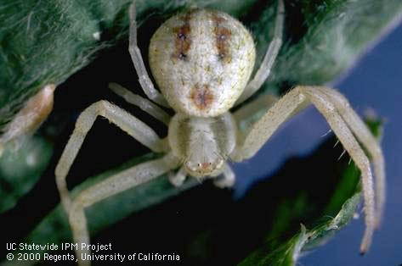
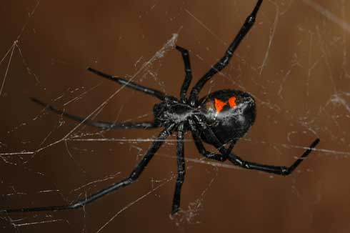
Spiders (Arachnida)
Mostly beneficial predators
Most are unlikely to bite people
Are not insects: Have 8 legs and 2 body parts
Hunts without a web
Spins a web
Notes:
8
Spiders are mostly beneficial predators of insects and other arthropods. Most cannot harm people. Spiders that might injure people (such as black widows) spend most of their time hidden. Most spiders seen in the open during daylight are unlikely to bite people.
Spiders are not insects. Spiders have 8 legs and 2 body parts--a head region (cephalothorax) and abdomen. Common spiders can be identified to family by body shape, web type, hunting or other behavior, and the arrangement and relative size of their (usually 8) eyes.
Some spiders spin webs but others such as the crab spider at left hunt without webs.
Photos: Crab spiders are day-active hunters without webs (left); Female western black widow spider upside down in her web (right)
More information online:
http://www.ipm.ucdavis.edu/PMG/PESTNOTES/pn7442.html

Slide 9
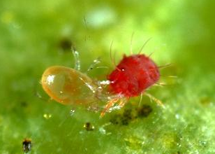
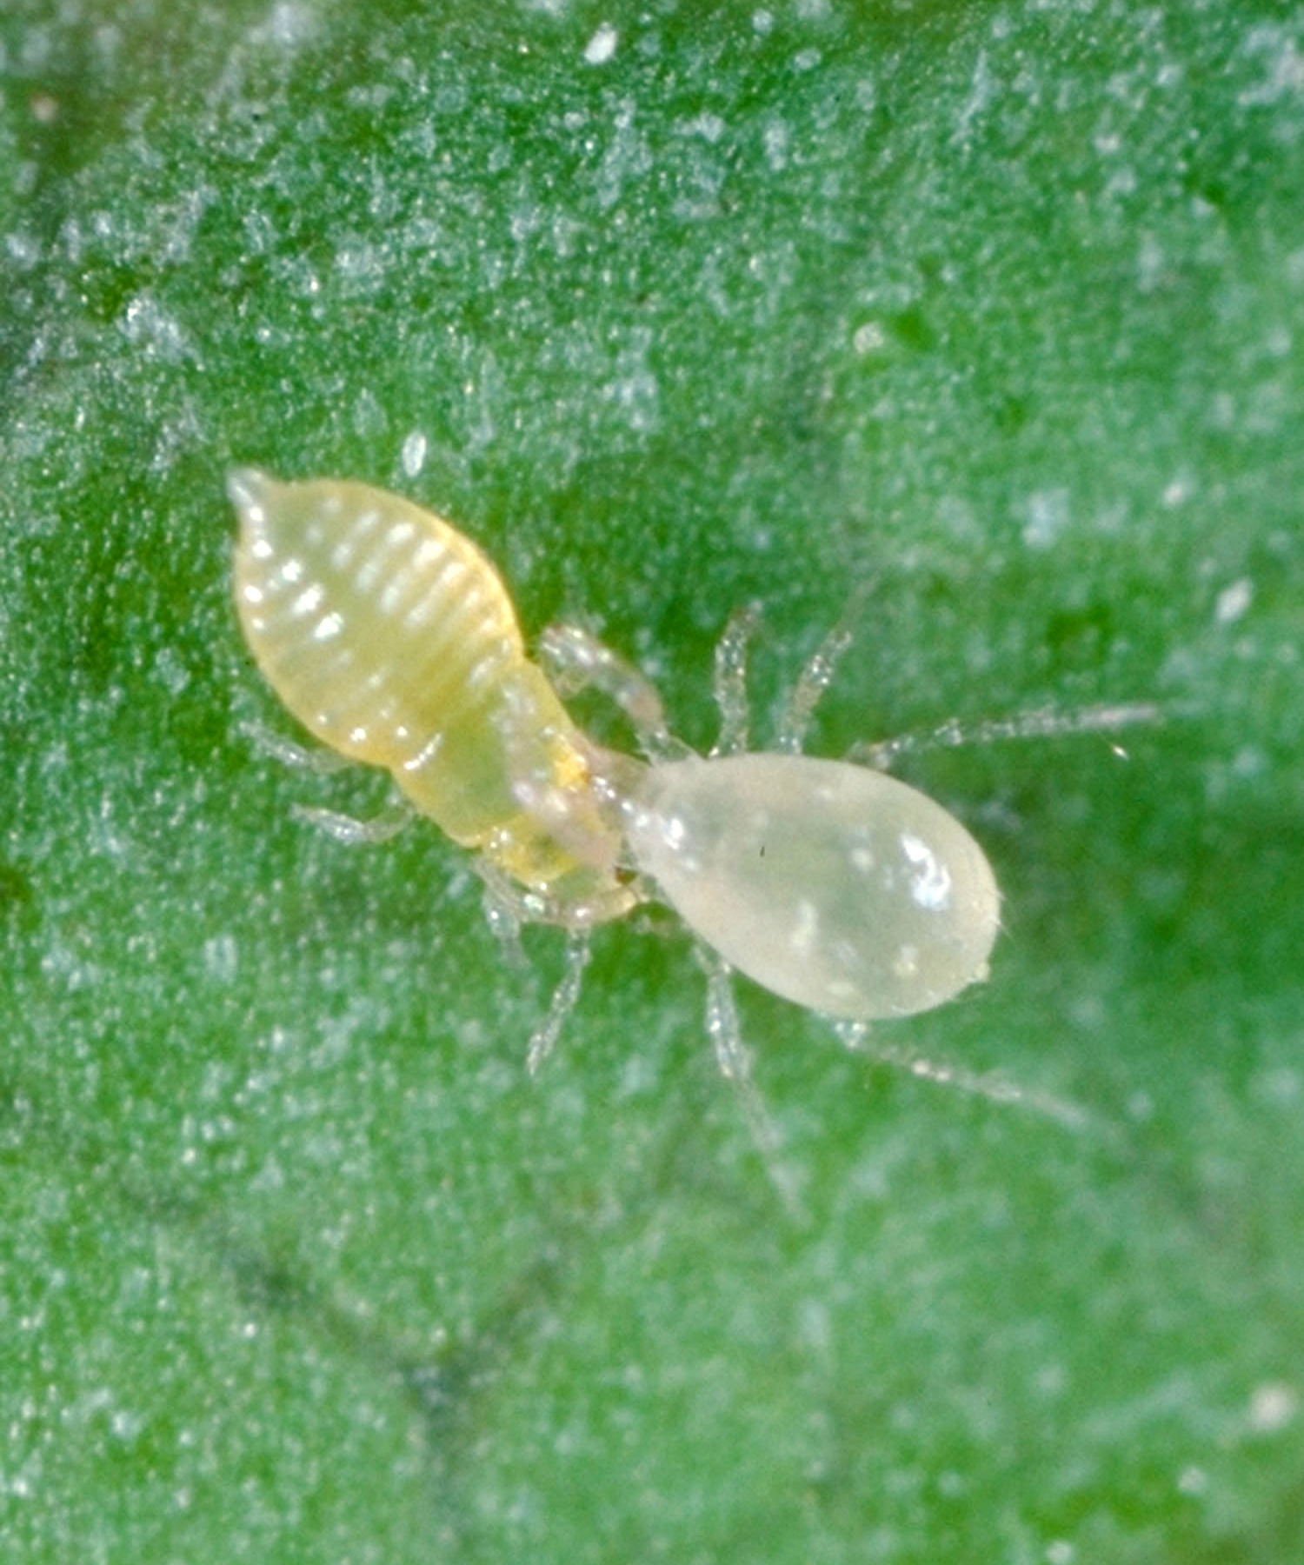
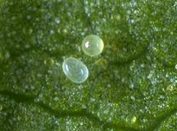
Predatory Mites (e.g., Phytoseiidae family)
Prey on:
pest mites
scales
thrips
whitefly nymphs
insect eggs
Predator mite (left) eating pest mite
Predator mite (right) and thrips
Pest egg (top): Predator egg
Notes:
Mites are related to spiders. Some mites are pests, but predatory mites (such as those in the family Phytoseiidae) eat pest mites and insects such as scales, thrips, and whitefly nymphs and insect eggs. Phytoseiid mites hatch from an oblong egg, then develop through 3 nymphal stages before becoming adults.
Predatory mites are faster moving than pest mites and their eggs are more oval.
Photos: Female predatory mite eating red mite (top left); Eggs of predator (oval) and spider mite (round) (bottom left); Female predatory mite attacking citrus thrips (right)
More information online: http://www.ipm.ucdavis.edu/PMG/NE/index.html

Slide 10
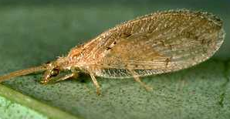
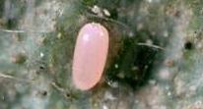
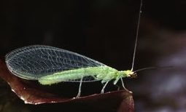
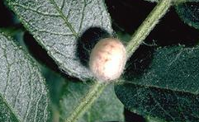
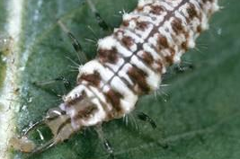
Green Lacewings (Chrysopidae) Brown Lacewings (Hemerobiidae)
Larvae feed on mites and insects:
aphids
caterpillars
mealybugs
psyllids
scales
whiteflies
Adult
Egg
Adult
Eggs
Pupa
Larva
Notes:
Both green and brown lacewings may occur in the garden, but green ones are more common. At maturity, brown lacewings are about 1/2 as large as green lacewings. Lacewing larvae feed on mites and small insects, including aphids, caterpillars, mealybugs, psyllids, scales, and whiteflies. Adults of brown lacewings and some green lacewing species are predaceous. Adults of other green lacewing species consume only honeydew, nectar, and pollen.
Lacewings develop through four life stages-egg, larva, pupa and adult. Adult green lacewing females lay eggs singly or in groups attached by a long, threadlike stalk that helps protect eggs from predation. Larvae molt through three instars, then pupate in a round silken cocoon. Green lacewings are available commercially for release, but releases generally are not effective in gardens and landscapes.
Photos: Brown lacewing adult (top left); Green lacewing adult (middle left); Green lacewing pupa (bottom left); Green lacewing eggs (top right); Brown lacewing egg (middle right); Green lacewing larva (bottom right)
More information online:
http://www.ipm.ucdavis.edu/PMG/NE/green_lacewing.html
http://www.ipm.ucdavis.edu/PMG/NE/brown_lacewing.html

Slide 11
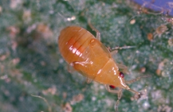
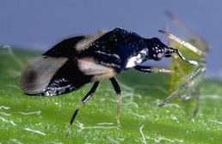
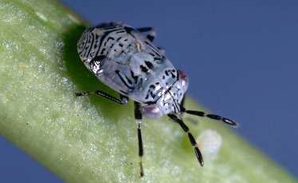
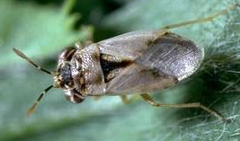
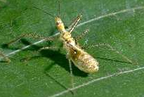
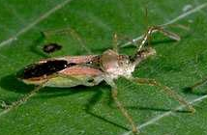
Predatory Bugs (Heteroptera)
Minute pirate bugs (Anthocoridae) prey:
aphids, mealybugs, mites, psyllids, small caterpillars, scales, thrips, and whiteflies
Bigeyed bugs (Geocorinae) prey:
other bugs, flea beetles, small caterpillars, and mites
Assassin bugs (Reduviidae) stalk:
caterpillars, leafhoppers, various small to medium, mobile insects
(Nymph) Minute pirate bug (Adult)
(Nymph) Bigeyed bug (Adult)
(Nymph) Assassin bug (Adult)
Notes:
Although some true bugs are plant-feeding pests, many other species use their sucking mouthparts to feed on insects and are important predators.
Predators in the true bug group prey on a great variety of invertebrates.
Some examples of predatory bugs include:
Minute pirate bugs (Anthocoridae family) which eat thrips, all stages of mites, insect eggs, aphids, mealybugs, psyllids, whiteflies, and small caterpillars. If feeding on mites, minute pirate bugs consume 100 or more in a lifetime. Nymphs are pear-shaped, yellow to orangish, and. have distinctly red eyes. Females typically insert their eggs into plant tissue.
Another common group is the bigeyed bugs (Geocorinae subfamily of Lygaeidae) - Adults and nymphs actively search low-growing plants for prey, including other bugs, insect eggs, flea beetles, small caterpillars, and mites. They are tiny (1/6 inch long or less) and have a wide head with prominent bulging eyes.
A third group of much larger bugs is the assassin bugs (Reduviidae family) - Both adults and nymphs feed on caterpillars, leafhoppers, and a variety of other small- to medium-sized, mobile insects. Adults and nymphs stalk or lay in wait for prey, which they impale with their extended, needlelike beak.
Photos: Minute pirate bug, Orius tristicolor (top); Bi eyed bug, Geocoris punctipes (middle); Assassin bug, Zelus renardii (bottom)
More information online:
http://www.ipm.ucdavis.edu/PMG/NE/minute_pirate_bug.html
http://www.ipm.ucdavis.edu/PMG/NE/bigeyed_bugs.html
http://www.ipm.ucdavis.edu/PMG/NE/assassin_bugs.html
http://www.ipm.ucdavis.edu/PMG/NE/damsel_bug.html

Slide 12
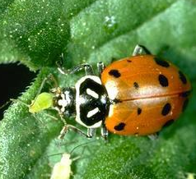
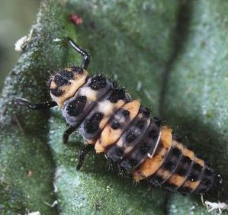
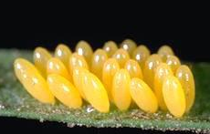
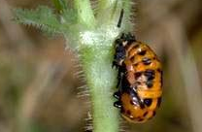
Lady Beetles (Coccinellidae)
Adult
Larva
The most effective predators specialize on certain prey
Convergent lady beetles mostly eat aphids
Eggs
Pupa
Notes:
12
Lady beetles in the Coccinellidae family are the most well-known predators in the landscape. Many lady beetles specialize on certain prey making them more effective at controlling pests than general predators like lacewings. For instance the convergent lady beetle shown here specializes on feeding on aphids.
All lady beetles develop through four life stages: egg, 3 larval instars, pupa, and adult. Adult convergent lady beetles are about 1/5 inch long and mostly orange. Most individuals have 13 black spots on their wing covers. However, some individuals have fewer spots or no spots at all. Oblong eggs are laid in groups or scattered singly. Larvae are long-legged predators that resemble tiny alligators. Pupae are often found attached to stems or leaves.
Photos: Convergent lady beetle, Hippodamia convergens, adult (top left), larva (top right), eggs (bottom left), pupa (bottom right)
See also supplemental information: Some lady beetles migrate and aggregate seasonally http://www.ipm.ucdavis.edu/PMG/FIG/neh-f8-2.html
http://www.ipm.ucdavis.edu/PMG/NE/convergent_lady_beetle.html

Slide 13
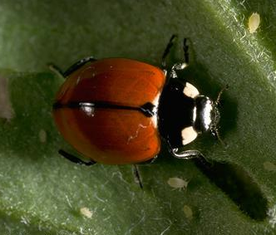
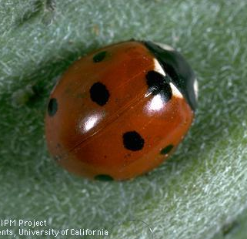
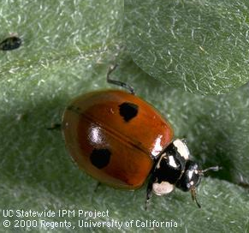
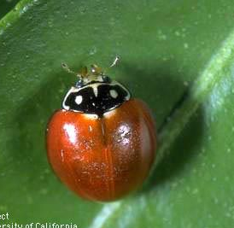
Lady Beetles – Aphid Specialists Usually are orangish species
California lady beetle
Sevenspotted lady beetle
Twospotted lady beetle
Western blood-red lady beetle
Notes:
13
Lady Beetles that specialize on aphids are usually orangish-reddish species. Examples shown here are :
California lady beetle (Coccinella californica)
Sevenspotted lady beetle (Coccinella septempunctata)
Twospotted lady beetle (Adalia bipunctata)
Western blood-red lady beetle (Cycloneda polita)
Photos: Sevenspotted lady beetle (top right); California lady beetle (top left), Twospotted lady beetle (bottom left); Western blood-red lady beetle (bottom right).
More information online:
http://www.ipm.ucdavis.edu/PMG/NE/coccinella_septempunctata.html

Slide 14
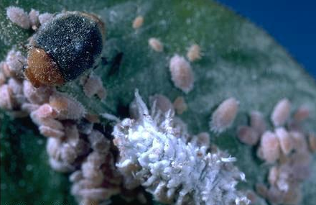
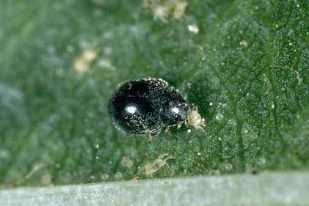
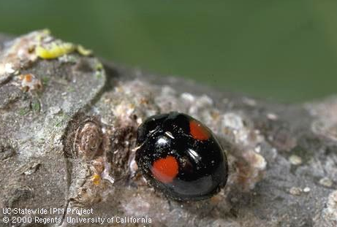
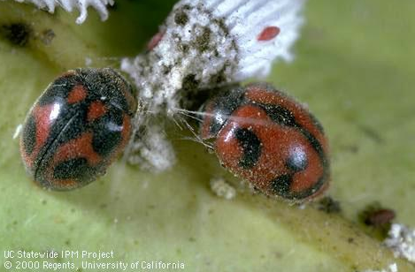
Lady Beetles – Specialized Predators
Mealybug destroyer→mealybugs
Spider mite destroyer→mites
Twicestabbed→scales
Vedalia→cottony cushion scale
Notes:
14
Other Lady Beetles specialize on feeding on other types of pests. For instance:
The mealybug destroyer (Cryptolaemus montrouzieri) mostly eats mealybugs
The spider mite destroyer (Stethorus picipes) eats spider mites
Twicestabbed lady beetle (Chilocorus orbus) eats scale insects
Vedalia beetle (Rodolia cardinalis) eats cottony cushion scale
Photos: Mealybug destroyer (top left); Spider mite destroyer (top right); Twicestabbed ladybeetle (bottom left); Vedalia beetle (bottom right)
More information online:
http://www.ipm.ucdavis.edu/PMG/NE/mealybug_destroyer.html
http://www.ipm.ucdavis.edu/PMG/NE/spider_mite_destroyer.html
http://www.ipm.ucdavis.edu/PMG/NE/twicestabbed_lady_beetle.html
http://www.ipm.ucdavis.edu/PMG/NE/vedalia_beetle.html

Slide 15
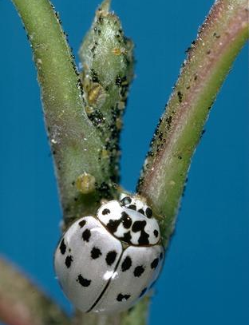
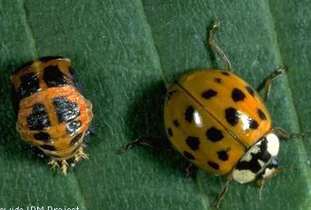
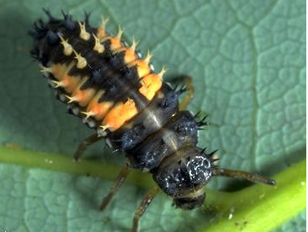
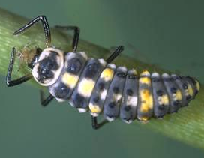
Lady Beetles – General Predator Species
These lady beetles eat:
aphids
mites
psyllids
scales
whiteflies
Ashy gray lady beetle
Multicolored Asian lady beetle
Notes:
15
The ashy gray lady beetle and multicolored Asian lady beetle are examples of lady beetles that prey on a variety of pests, including aphids, mites, psyllids, scales, and whiteflies.
The Ashy gray lady beetle (Olla v-nigrum) adult is usually pale yellowish to gray with black spots. A black form with two large red spots also occurs. Larvae are dark with yellowish spots.
Multicolored Asian lady beetle (Harmonia axyridis) is an introduced species. The adult has more than 100 color forms, including orangish or red with no spots or up to 19 large or small spots. Larvae are blackish and orange and spines
Photos: Ash gray lady beetle, Olla abdominalis, adult (top left) and larva (bottom left); Multicolored Asian lady beetle, Harmonia axyridis, pupa and adult (top right) and larva (bottom right)
More information online
http://www.ipm.ucdavis.edu/PMG/NE/harmonia_axyridis.html

Slide 16
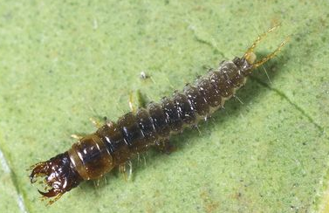
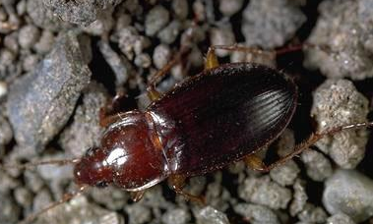
Predaceous Ground Beetles (Carabidae)
Adults and larvae live in litter and on soil.
Their prey includes:
insect eggs, larvae, and pupae
snails and slugs
Larva
Adult Calosoma sp.
Adult Calathus sp.
Notes:
16
Predaceous ground beetle (Carabidae family) adults and larvae live in litter and on soil. They feed on soil-dwelling insect eggs, larvae, and pupae; other invertebrates such as snails and slugs; and sometimes on seeds and organic litter.
Adults of common California species are medium to large black or brown beetles, about 1/3 to 2/3 inch long. Larvae are elongate and their heads are relatively large with distinct mandibles.
Photos: Adult predaceous ground beetle, Calasoma sp. (left); Carabid larva (top); Adult carabid, Calathus sp. (bottom right)
See also supplemental information: Carabids resemble plant-feeding darkling ground beetles
http://www.ipm.ucdavis.edu/PMG/NE/predaceous_ground_beetle.html

Slide 17
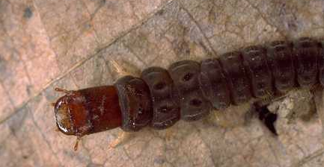
Soldier beetles (Cantharidae) – Leather-winged Beetles
Soil dwelling larva
Larvae are general predators
Feed under bark or in soil or litter
Prey on invertebrates, e.g., eggs and larvae of beetles and moths
Adults prefer aphids
Also eat pollen so often seen on flowers
Adult
Notes:
17
Soldier beetles, also called leather-winged beetles belong to the Cantharidae family.
Soldier beetle larvae are dark, elongate, and flattened. They feed under bark or in soil or litter on invertebrates, including eggs and larvae of other beetles and moths.
Adults (like this Cantharis sp.) are long and narrow, usually with an orangish head and thorax and dark wing covers. Soldier beetle adults prefer aphids, but they also feed on pollen so are often observed on flowers.
Photos: Soil dwelling larva (top); Adult (bottom)
More information online:
http://www.ipm.ucdavis.edu/PMG/NE/soldier_beetles.html

Slide 18
Syrphid flies (Syrphidae) –Flower Flies or Hover Flies
Adult
Egg
Adults not predaceous:
Eat pollen and nectar
Often visit blossoms
Larvae are specialized:
Usually eat aphids
Also eat soft-bodied mealybugs, psyllids, whiteflies
Larva
Pupa
Notes:
18
Syrphid flies (also called Flower flies, or Hover flies) are common in gardens. Syrphid fly larvae are specialized predators, usually feeding on aphids but sometimes on other soft-bodied insects. One syrphid larva can consume hundreds of aphids during its development. Adult syrphids are not predaceous and eat pollen and nectar, and often are observed visiting blossoms.
Syrphids are true flies (in the order Diptera) and develop through 4 life stages: egg, larva, pupa, and adult. Adults of many species have black and yellow or whitish bands on top of their abdomen and resemble wasps or bees. However, adult syrphids have only 1 pair of wings and cannot sting. Syrphid larvae are maggotlike and don’t have true legs like caterpillars. They vary in color and may be translucent. Pupae are oblong to pear-shaped.
Photos: Adult (top left); Egg (top right); Large hover fly larva (bottom left); Pupa (bottom right)
More information online:
http://www.ipm.ucdavis.edu/PMG/NE/syrphid_flies.html

Slide 19
Mantids (Mantidae) – Praying Mantids
These fascinating creatures should be preserved
They eat both beneficials and pests and are not reliable for controlling pests
Adult
Egg case
Nymph
Notes:
19
A discussion of predators would not be complete without mention praying mantids.
These fascinating creatures should be preserved, but they do not effectively control pests because they indiscriminately eat both beneficials and pests.
Photos: Adult (top); Egg case (bottom left); Nymph (bottom right)
More information online:
http://www.ipm.ucdavis.edu/PMG/NE/mantids.html

Slide 20
Parasites (technically Parasitoids)
Wasp laying egg in aphid host
Caterpillar parasitoid
Most are wasps or flies
Often smaller than their host
Kills only one host individual
Develop inside or outside of the host
Adult females in certain species feed on hosts
Aphid parasite life cycle
Notes:
In contrast to predators, insect parasites (technically called parasitoids) kill only one insect during their larval stage. However, because females lay many eggs, they can be very effective biological control agents. Insect parasites are wasps or flies that lay their eggs on or inside a host insect. Adults are free-living and are often smaller than the host they attack—thus the moniker mini-wasp. Larval stages of insect parasites feed inside their hosts, kill the host just before pupating, then emerge as an adult. Some parasites emerge as mature larvae and pupate outside the dead host.
Photos: Wasp laying her egg in an aphid (top left); Wasp laying her egg in a caterpillar (top right)
Illustrations: Aphid parasite life cycle (bottom)
See also supplemental information: Parasite definition (versus Parasitoid)
http://www.ipm.ucdavis.edu/PMG/glossary.html#P

Slide 21
Signs of Parasitization
Adult wasps are very small. You will more likely see evidence of parasite activity:
Hosts that darken or differ in color from normal
The immature parasite itself is sometimes visible through the host’s surface
Dark parasitized scales
Parasite cocoons or pupae
Dark parasitized eggs
Notes:
21
Signs of Parasitization
Many species of parasitic wasps are very small. Rather than the parasite itself, you’ll more likely see evidence of parasite activity:
Hosts that darken or differ in color from normal, unparasitized individuals like the scales above.
The immature parasite itself is sometimes visible through the hosts' surface as is the case with the corn earworm eggs parasitized by a Trichogramma wasp in the photo below.
You may observe pupal cases of parasitic wasps, such as the fluffy white parasite cocoons next to the redhumped caterpillars at right.
Also, sometime exit holes chewed by an emerging parasite are visible on the bodies of dead parastized insects.
Photos: European fruit lecanium scales turn black when parasitized by the wasp Coccophagus lecanii (top left); Caterpillar eggs parasitized by Trichogramma wasps darken (bottom left); White pupal cases of the redhumped caterpillar parasite, Cotesia sp., next to unparasitized caterpillars. (bottom right).
More information online:
http://www.ipm.ucdavis.edu/PMG/NE/trichogramma_spp.html

Slide 22
Aphid Parasites
When an aphid parasite pupates, it causes mummification:
The host is killed and bloats
The outside becomes firm and crusty and may change color
After the parasite emerges, it may leave a hole in the pest it killed
Black aphid “mummy”
Adult wasp and exit hole
Aphid mummy
Healthy aphid
Notes:
22
Aphid parasites
Mummified aphids are a commonly seen example of parasitization. When the larva of an aphid parasite pupates, the host is killed, causing it to bloat and form a “mummy”. After about 5 or more days, the host's outside becomes firm and crusty and often changes color—usually beige or black. After the adult parasite emerges, it may leave an obvious hole in the surface of the pest it killed.
Photos: Healthy potato aphid and crusty black mummified aphid parasitized by aphelinid wasp (top left); Crusty beige aphid mummy parasitized by aphidiid wasp (bottom left); This Lysiphlebus testaceipes adult parasite has just emerged from a cotton aphid mummy (bottom right)
More information online:
http://www.ipm.ucdavis.edu/PMG/NE/lysiphlebus_testaceipes.html
http://www.ipm.ucdavis.edu/PMG/NE/aphidius_spp.html

Slide 23
Pathogens
Healthy
Beneficial microorganisms that cause disease:
Bacteria
Fungi
Viruses
Insect-killing nematodes
Virus infected
Fungus infected
Nematode infected
Healthy
Notes:
23
A third group of natural enemies that kills insect pests is pathogens. Pathogens are microorganisms that cause disease. Beneficial pathogens that kill mites and insects include:
Bacteria
Fungi
Viruses
and entomopathogenic (or insect-killing) nematodes. The darkened lawn grub at right has been killed by nematodes.
Photos: Healthy tiger moth caterpillar, Lophocampa argentata, crawling on top of twig and infected caterpillars hanging down from twig (top); Healthy soil dwelling scarab grub (white) and nematode infected grub (pink) (bottom right); Rose aphids, Macrosiphim rosae, killed by a fungus (bottom left)

Slide 24
Pathogens
Bacillus thuringiensis or Bt subspecies kurstaki
Kills only caterpillars that eat Bt-sprayed plants
Bt subsp. israelensis (Bti) kills larvae of fungus gnats, mosquitoes and certain other flies.
Bt-killed caterpillar
Bti for mosquitoes
Notes:
24
Bacillus thuringiensis or Bt subspecies kurstaki, used to kill leaf and bud-feeding caterpillars, is the most commonly used commercially available insect pathogen. It is sold as an insecticide. Caterpillars stop feeding within a day of eating Bt-treated foliage. Within several days, the caterpillars darken and die. Bt does not affect butterflies and moths or their eggs and pupae.
Bt subspecies israelensis (Bti) kills larvae of fungus gnats, mosquitoes, and certain other flies and is sold in several formulations including mosquito dunks.
Many other beneficial pathogens occur naturally in landscapes. Because they only affect specific insect groups and do not harm people, pets or wildlife, these biological control agents are very safe for the environment.
Photos: Diagram of using Bt sprays to control caterpillars (left). Bacillus thuringiensis-killed looper (middle); The Bt israelensis subspecies is available as dunks for killing mosquito larvae (right)

Slide 25
Use an IPM Program
Following an IPM program is a great way to preserve and encourage natural enemies.
Identify the pest
Learn its common natural enemies
Preserve and enhance their effectiveness
Notes:
25
The best way to preserve and encourage the natural enemies that are already in your yard is to use an integrated pest management (or IPM) program. To employ IPM, you must first identify the pest and confirm it is causing damage. Then find out what its common natural enemies are and take steps to protect them such as avoiding the use of insecticides that kill beneficials and relying on nonchemical management practices whenever possible.

Slide 26
Pesticide Toxicity to Natural Enemies
Insecticide | Contact Toxicity (immediate killing) | Persistence of Toxic Residue*
Bacillus thuringiensis | No contact | No persistence
Oils/Soaps | Moderate contact | No persistence
Botanicals (pyrethrins/azadirachtin) | Moderate to High contact | Short persistence
Spinosad | Moderate contact | Intermediate persistence
Organophosphates/ Carbamates/Pyrethroids | High contact | Intermediate to long persistence
Imidacloprid: Foliar spray | Variable: Most natural enemies affected | Intermediate persistence
Imidacloprid: Soil applied or root/trunk-injected | Bees, predatory beetles and nectar-feeding parasites affected | Long persistence
* Persistence is the length of time a pesticide remains toxic.
Intermediate = toxic for weeks; Long = toxic for months
Notes:
26
Pesticide Toxicity to Natural Enemies
Exposure to pesticides is one of the most common reasons natural enemies are killed in our landscapes. If insecticides are needed, use less-toxic products such as the ones shown here in green and yellow: Insecticidal soaps, horticultural (narrow-range) oil, botanicals that have short-residual toxicity, and selective products, such as Bt for caterpillars.
Stay away from persistent, broad-spectrum pesticides. These are shown in red:
Bifenthrin, permethrin, and other pyrethroids;
Organophosphates such as malathion; and
Carbaryl, a carbamate sometimes sold under the brand name Sevin.
Applications of these pesticides leave toxic residues that will kill natural enemies for weeks.
Imidacloprid (Merit, Bayer 12-Month Tree & Shrub Insect Control) is useful for long-term control of certain sucking and chewing pests. However, when:
Sprayed on foliage, it adversely affects most natural enemy insects and is somewhat persistent.
Applied to soil or injected into roots or trunks, imidacloprid can be toxic to bees, predatory beetles and parasites that feed on nectar of treated plants, and it is very persistent.
All these insecticides are sold under various brand names. Check labels for active ingredients.
More information online:
http://www.ipm.ucdavis.edu/PMG/menu.pesticides.html

Slide 27
Reduce Pest Problems With Proper Plant Care
Improve soil conditions and the plant growing environment
Provide good drainage
Irrigate plants appropriately
Avoid excess fertilization
Water plants near drip line
Provide good drainage by planting slightly high
Notes:
27
Reduce your reliance on insecticides by using gardening practices that promote healthy plants. Some methods include the following:
Improve soil conditions and the plant's growing environment with mulches and soil amendments.
Provide good drainage by planting in raised beds or on a mound slightly higher than the soil surface.
Irrigate plants appropriately. Water established plants near their drip line, not at the trunk.
Avoid excess fertilization, which promotes plant-sucking pests such as aphids and mites.
Illustrations: Water established plants near their drip line (left); Provide good drainage – for example plant slightly high (right)

Slide 28
Use Physical Controls
Traps
Water sprays
Reflective mulches when plants are small
Sticky barriers
Row covers
Hose off aphid-infested plants
Trap snails and slugs
Notes:
28
Use nonchemical physical controls whenever appropriate to control pests. For instance:
Traps for earwigs, snails and slugs
Water sprays:
- such as hosing off aphid-infested plants.
- or regularly misting the underside of mite-infested leaves
Sticky barriers for ants, weevils.
Row covers to exclude egg-laying adults like root maggots or fleabeetles
Reflective mulches to reduce the ability of flying pests such as aphids, thrips, and whiteflies to find young plants.

Slide 29
Ants Often Protect Pests
Manage ants:
Avoid plants that attract honeydew-producers
Use sticky barriers
Install bait stations
Baits
Sticky barrier
Notes:
29
Ants often protect honeydew-producing pests such as aphids, soft scales, and whiteflies from natural enemies. Enhance biological control by:
Avoiding plants that attract honeydew-producing insects.
Using sticky materials to keep ants out of trees and shrubs.
And consider installing bait stations if necessary.
Photos: Sticky barrier on trunk wrap to exclude ants (left); Baits: pesticide enclosed with a food attractant (right)
More information online:
http://www.ipm.ucdavis.edu/PMG/PESTNOTES/pn7411.html

Slide 30
Plants that Improve Biological Control
Adults of many natural enemies eat pollen and nectar.
If provided, beneficials live longer and lay more eggs
Insectary plants may provide shelter and alternate prey
Plants with nectar and a long bloom season are best
Grow these beneficial-attracting plants in your landscape
buckwheats | dill
coreopsis | fennel
cosmos | mustards
sweet alyssum | yarrow
Queen Anne’s lace
Notes:
30
Parasitic wasps and flies and the adult stages of many insects with predaceous larvae feed on pollen and nectar. These beneficials will live longer and lay more eggs if they have access to nectar- and pollen-producing plants. These insectary plants can also provide shelter and sometimes alternate hosts for predaceous stages.
Flowering plants that have a long bloom season and produce nectar are best. Commonly used plants include:
buckwheats,
coreopsis,
cosmos,
sweet alyssum,
Queen Anne's lace,
dill,
fennel,
mustards,
yarrow

Slide 31
Using Biological Control
Releasing natural enemies can be somewhat effective in a few situations
Convergent lady beetles
Lady beetles for aphids
Insect-killing nematodes for lawn grubs and moths that bore in tree
Applying insect-killing nematodes
Notes:
31
What about purchasing and releasing natural enemies? (a practice called augmentative biological control.) Most natural enemies are not available for sale, and some species that are—such as praying mantids—are not effective. Three types of natural enemies that may be effective are the microbial insecticide products like BT discussed earlier, releases of lady beetles for aphid control in very special circumstances and entomophagous nematodes. Insect-killing entomopathogenic nematodes can be mail ordered and applied to control lawn grubs and larvae of certain moths that bore in trees. Additional natural enemy species are useful for pests in greenhouses and commercial agriculture.
In most cases, however, rely on naturally occurring biological control, nonchemical management methods and less toxic insecticides when necessary to manage pests in your landscape.
Photos: Convergent lady beetles, Hippodamia convergens, are field-collected and sold (top); Insect-killing nematodes (bottom)
See also supplemental information: Some lady beetles migrate and aggregate seasonally
http://www.ipm.ucdavis.edu/PMG/FIG/neh-f8-2.html
http://www.ipm.ucdavis.edu/PMG/NE/convergent_lady_beetle.html

Slide 32
Consult University of California Publications For More Information
Notes:
32
Consult University of California Publications for more information about biological control and less toxic IPM methods. Some publication resources include:
Natural Enemies Handbook
Pests of the Garden and Small Farm
Pests of Landscape Trees & Shrubs
Landscape Pest Identification Cards
These publications can be ordered online at the UC IPM web site, anrcatalog.com or purchased at your UC Cooperative Extension office.
UC IPM publications information online:
http://www.ipm.ucdavis.edu/IPMPROJECT/landscape resources.html
http://www.ipm.ucdavis.edu/FAQ/mgipm.html

Slide 33
Online at www.ipm.ucdavis.edu/PMG/menu.homegarden.html
Notes:
33
Go online to www.ipm.ucdavis.edu/PMG/menu.homegarden.html and view UC IPM’s Home and Landscape pest management resources, including the
Natural Enemies Gallery
Pest Notes, and
Diagnostic tools
UC IPM publications information online:
http://www.ipm.ucdavis.edu/IPMPROJECT/landscaperesources.html

Slide 34
Online at www.ipm.ucdavis.edu
Pest Notes
Natural Enemies Gallery
Notes:
34
The online Natural Enemies Gallery contains pictures and information to help you identify the common beneficial insects in your landscape.
See the Pest Notes series to read about managing specific pests as well as how to use biological control as part of an IPM program in your landscape.

Slide 35
www.ipm.ucdavis.edu
Statewide Integrated Pest Management Program
Notes:
This is the end of the biological control presentation. We hope you go out into your landscape and find some natural enemies!

